Slide 1
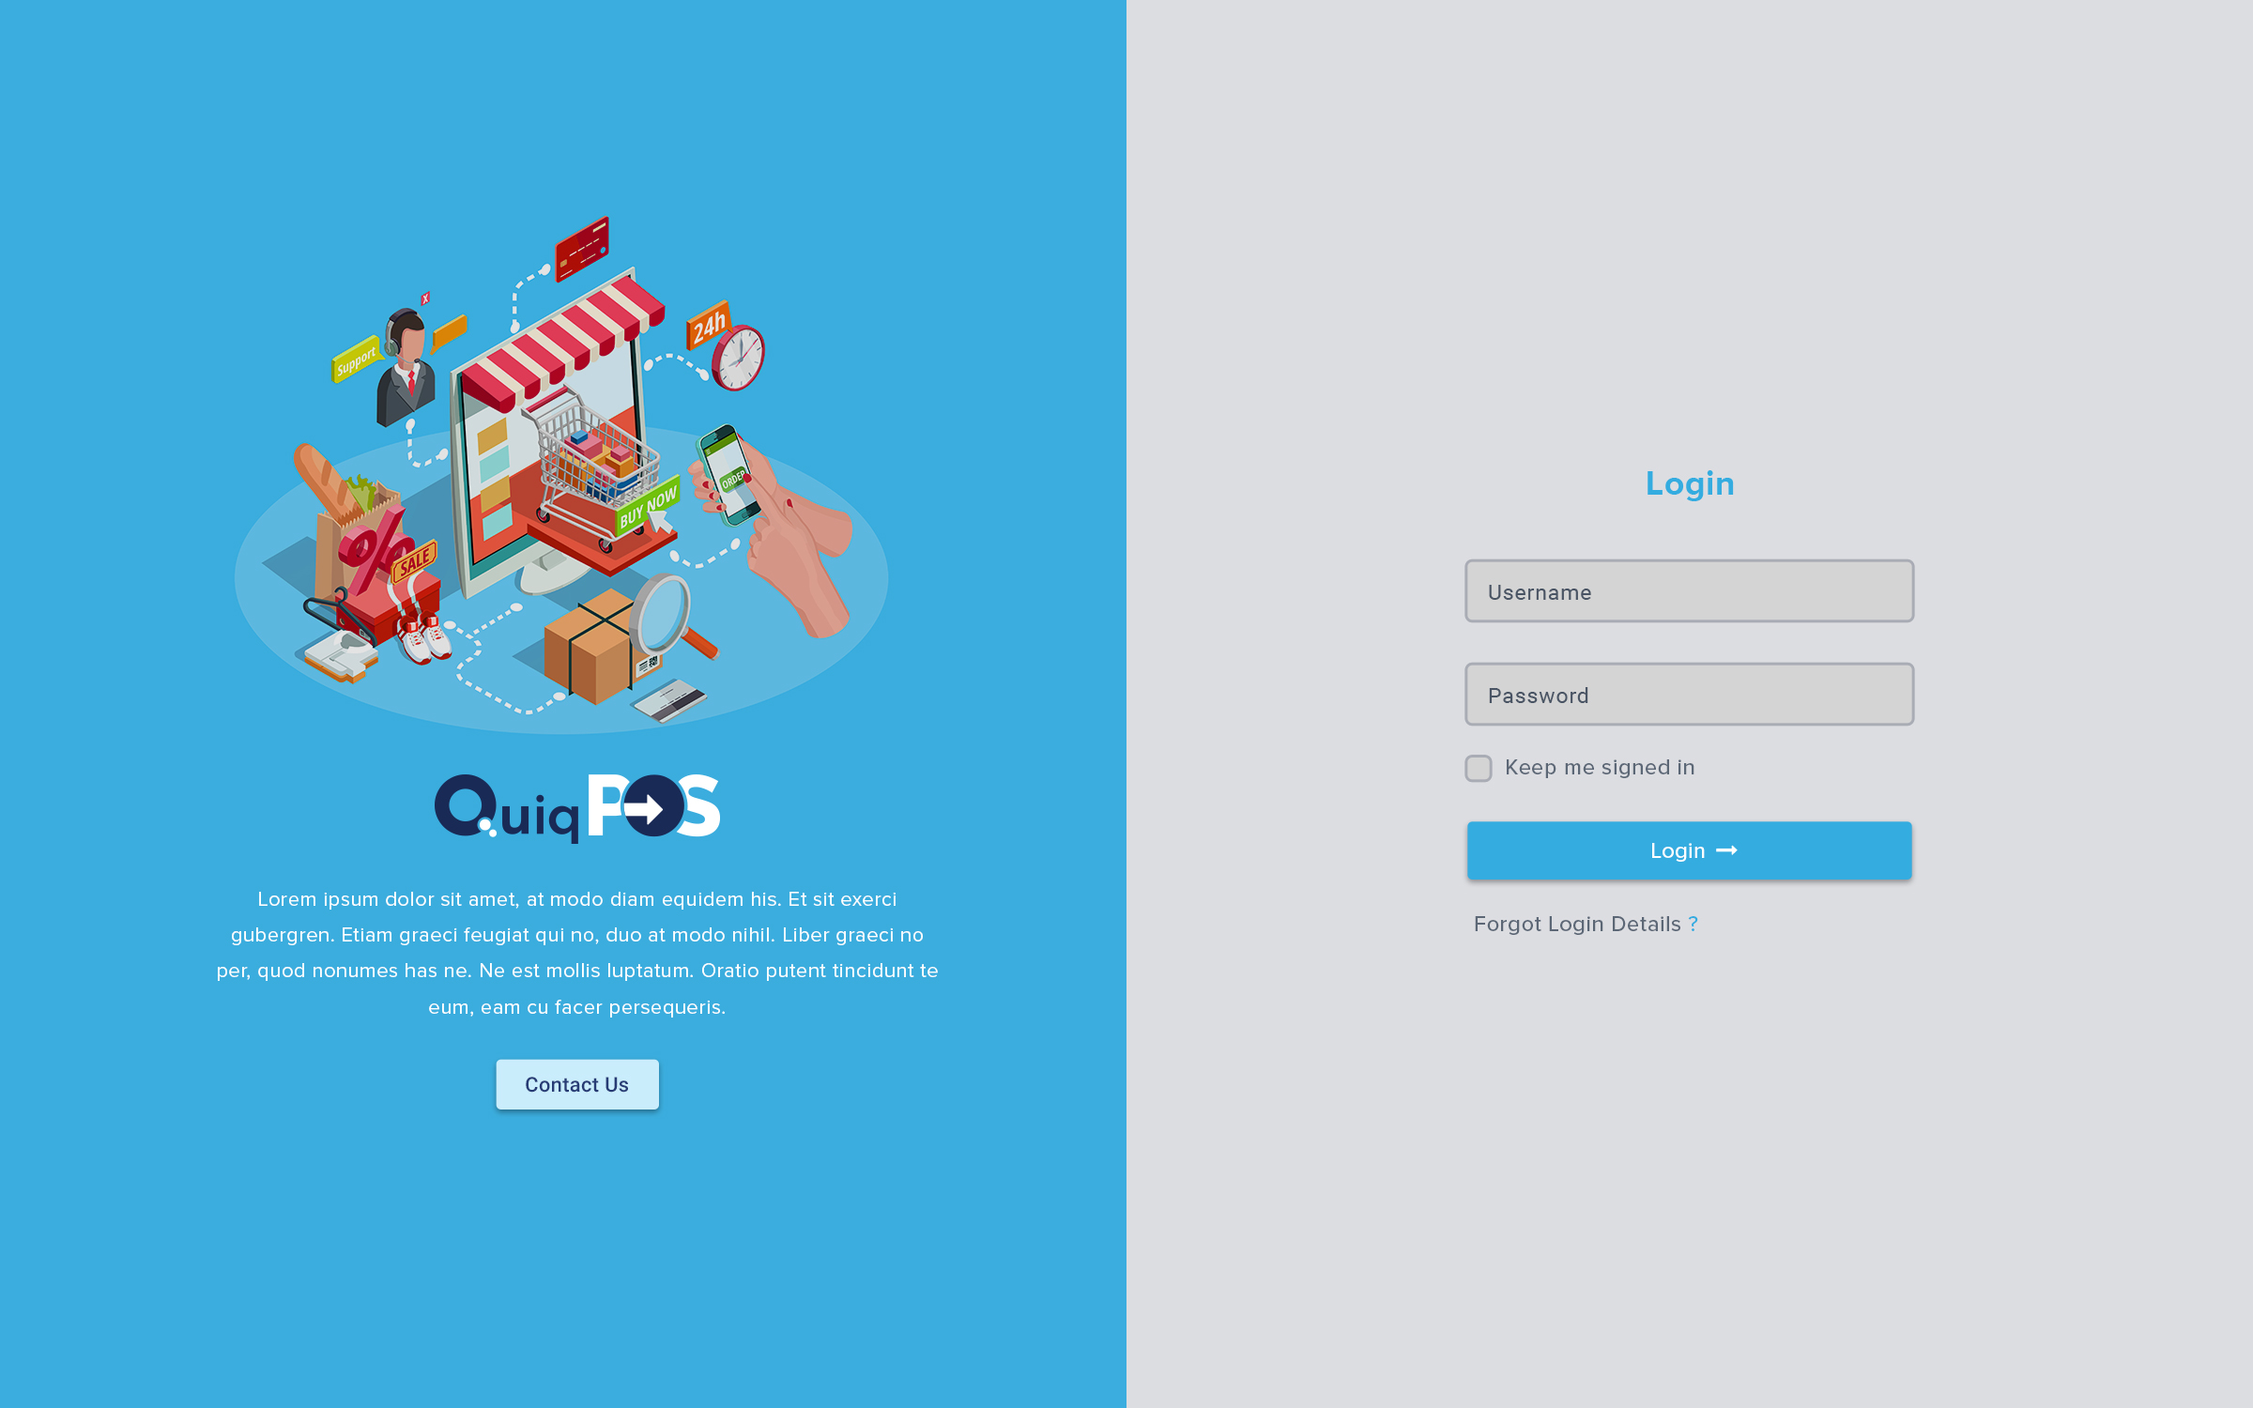

Slide 2
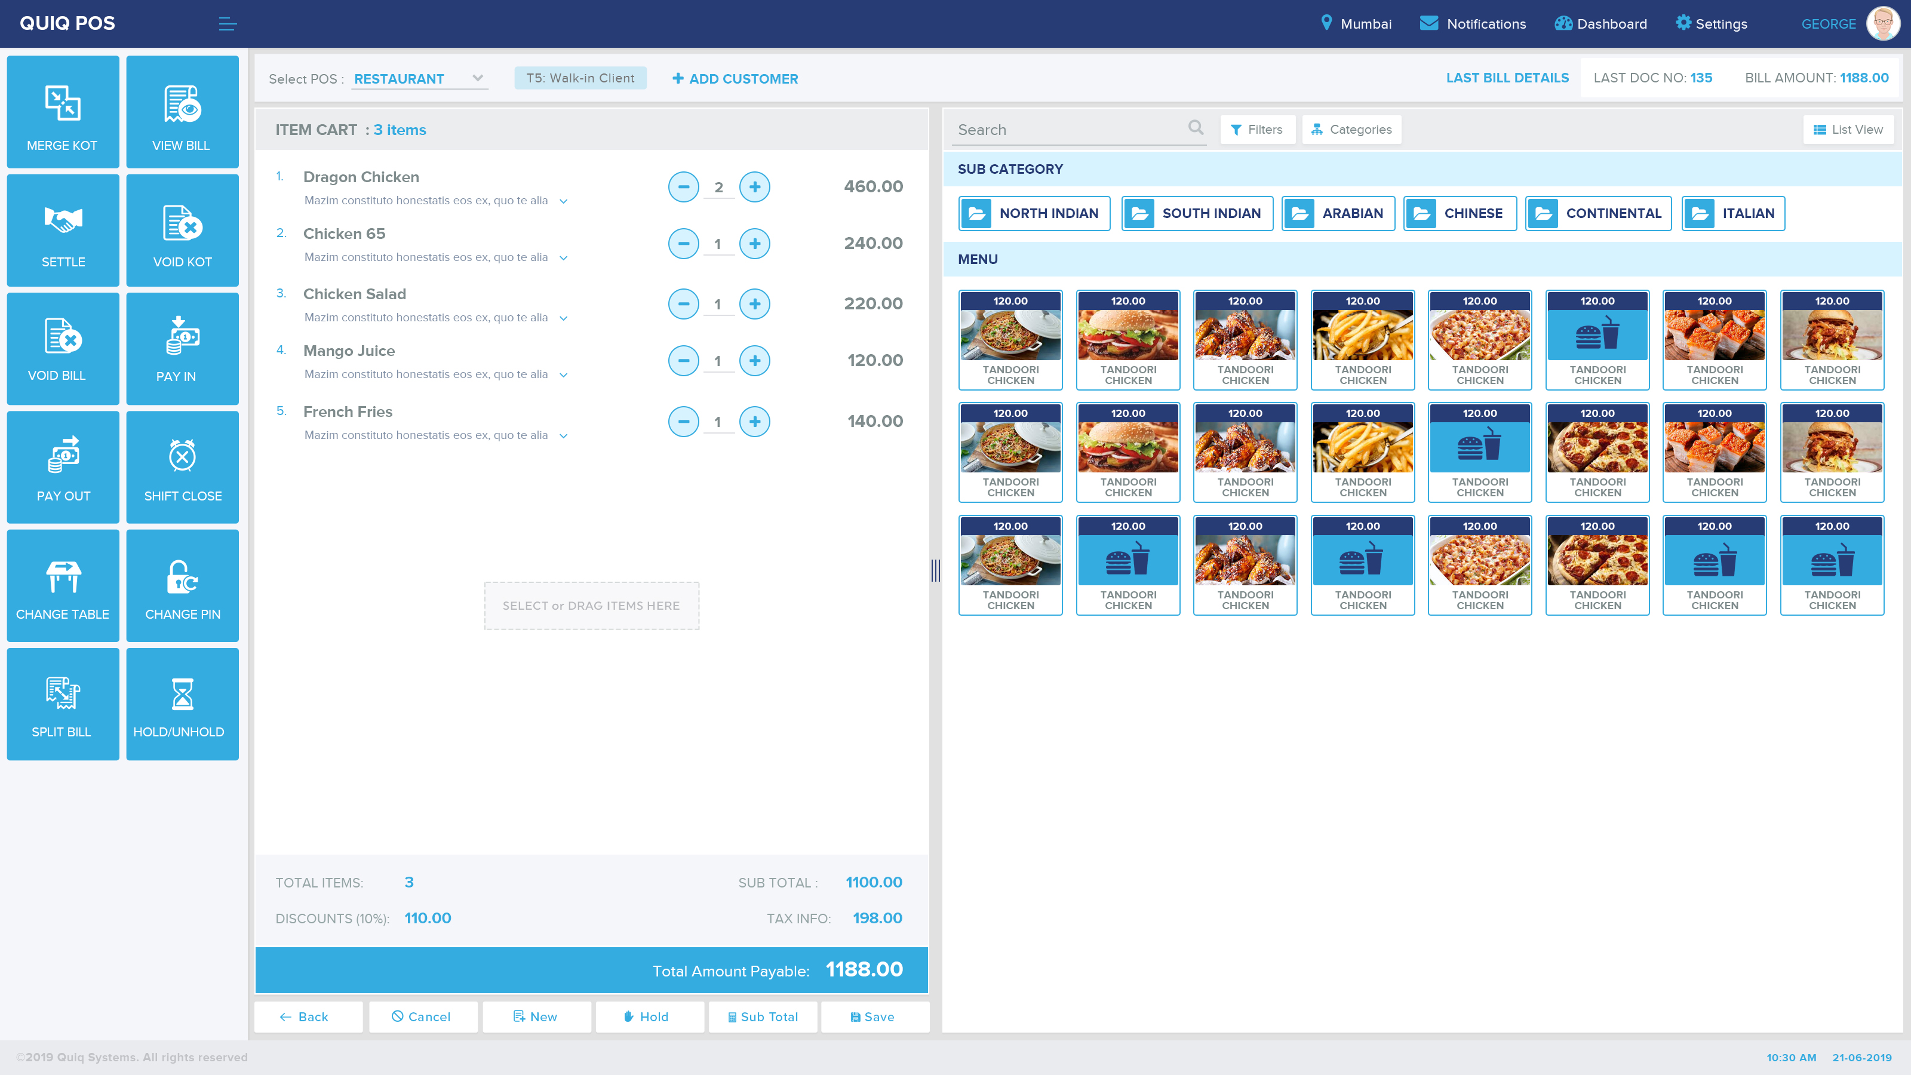
Tile Menu
for Easy Touch Access

Slide 3
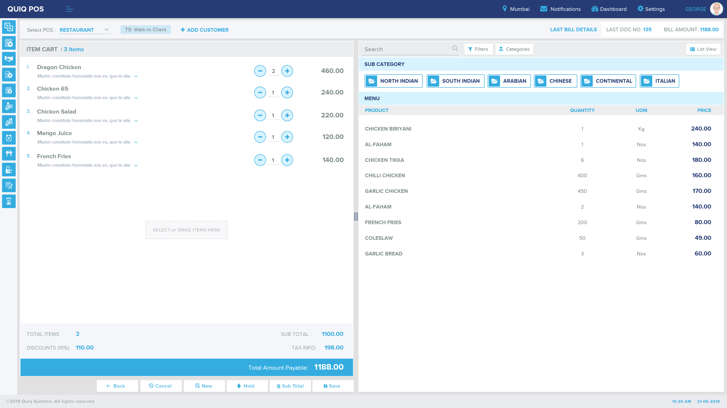
Collapsed Menu
for Desktop Users
Make more room for content area

Slide 4
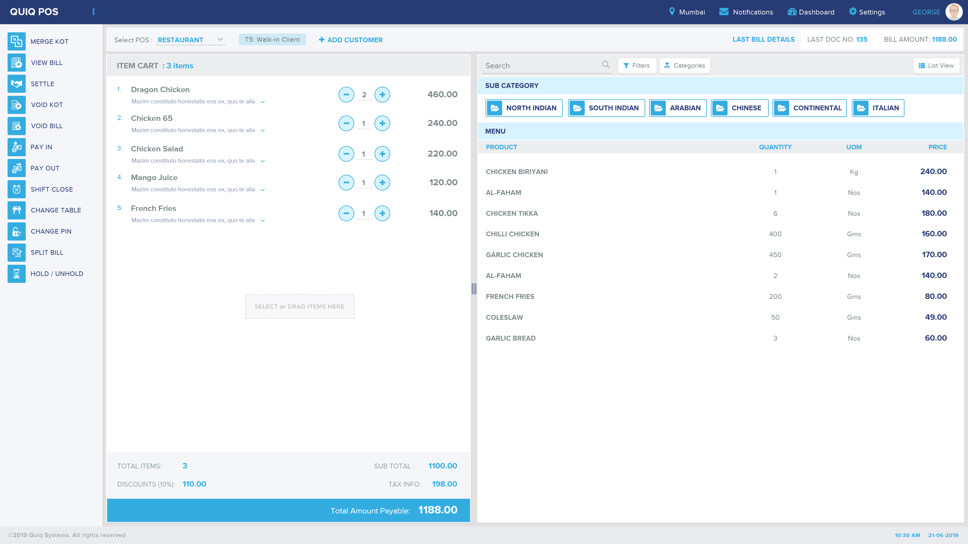
List Menu
for Typical
Desktop Users

Slide 5
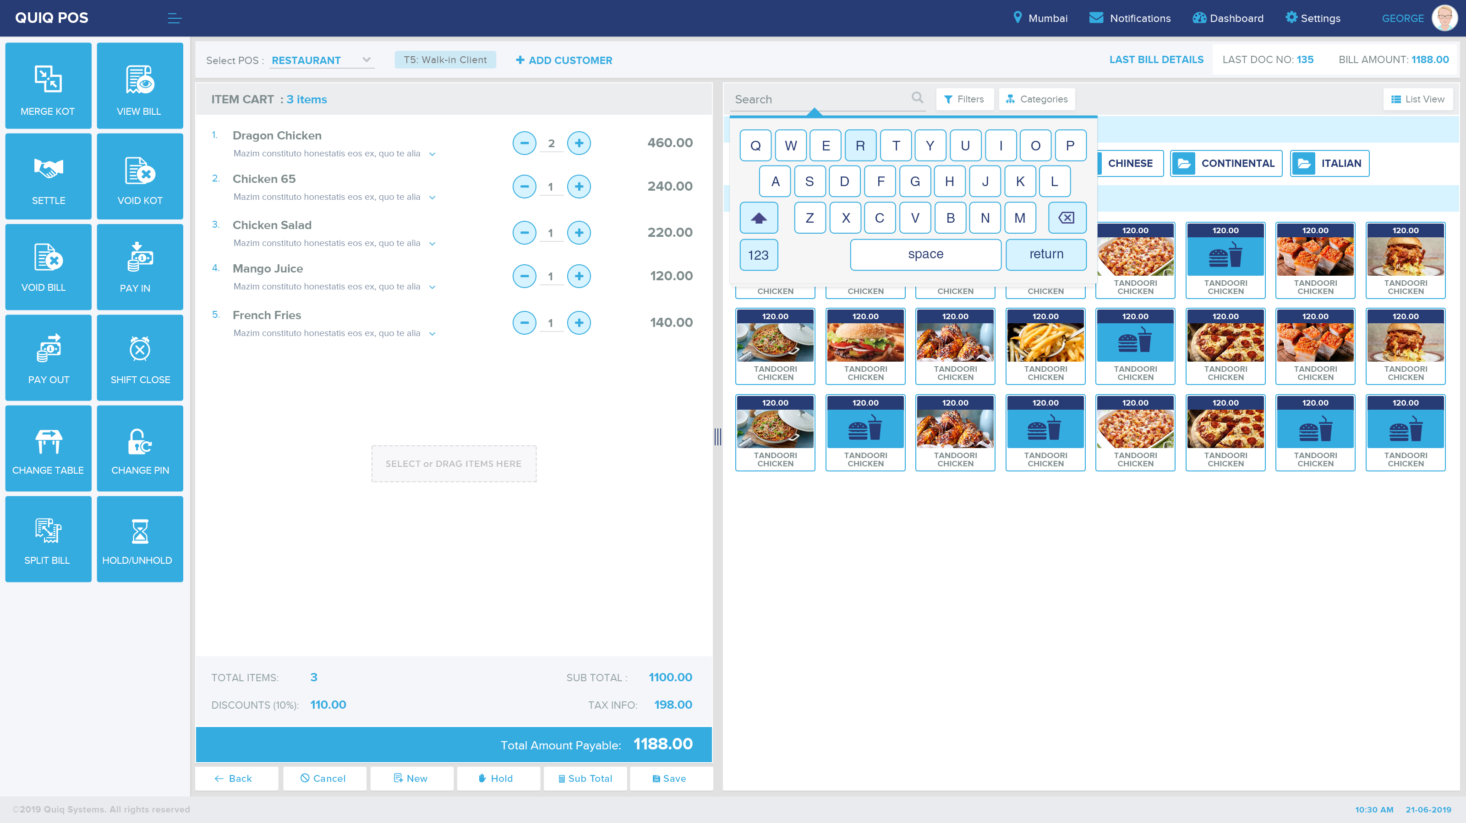
Application Keyboard for touch users

Slide 6
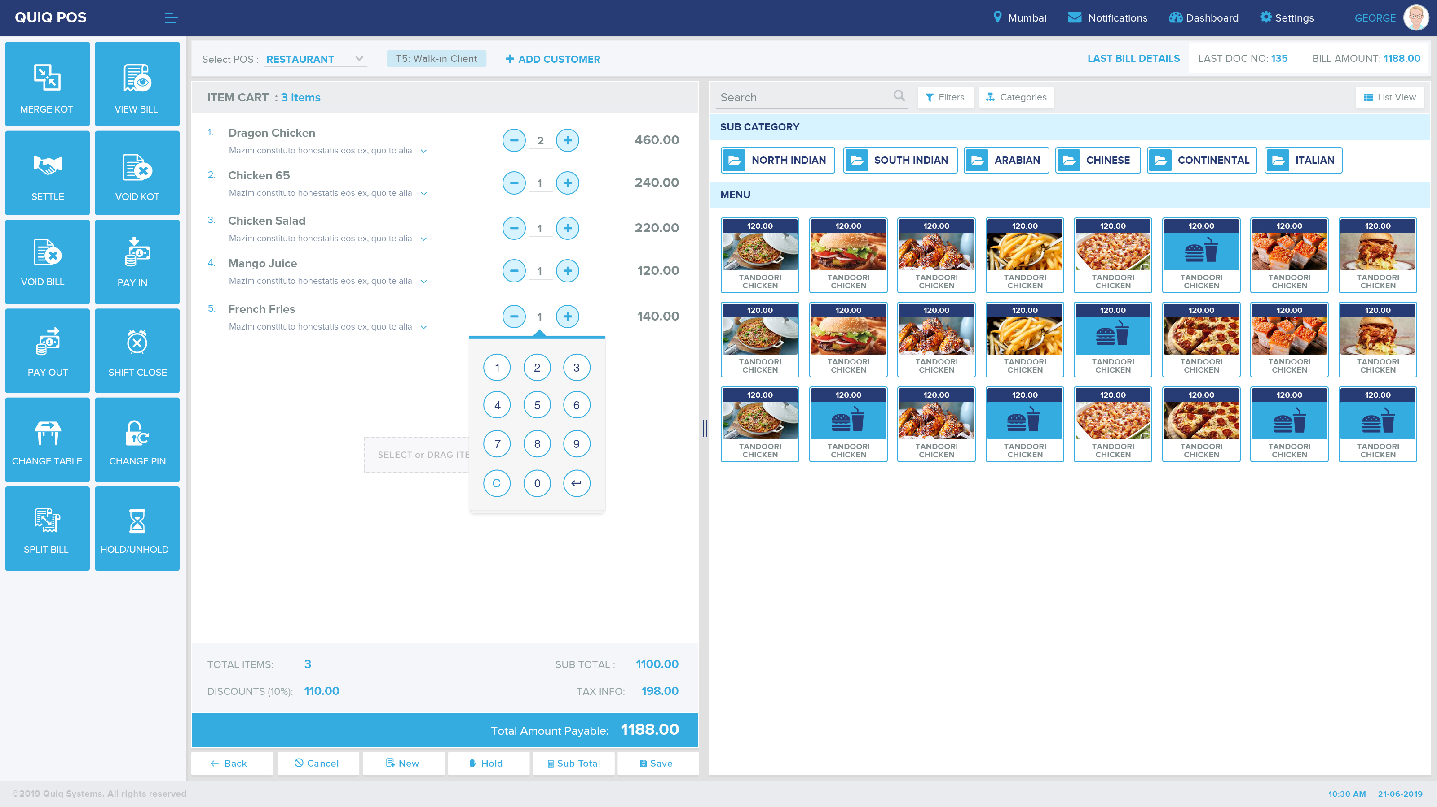
Numberpad for easy operation
Can be used alogside with the + - buttons

Slide 7
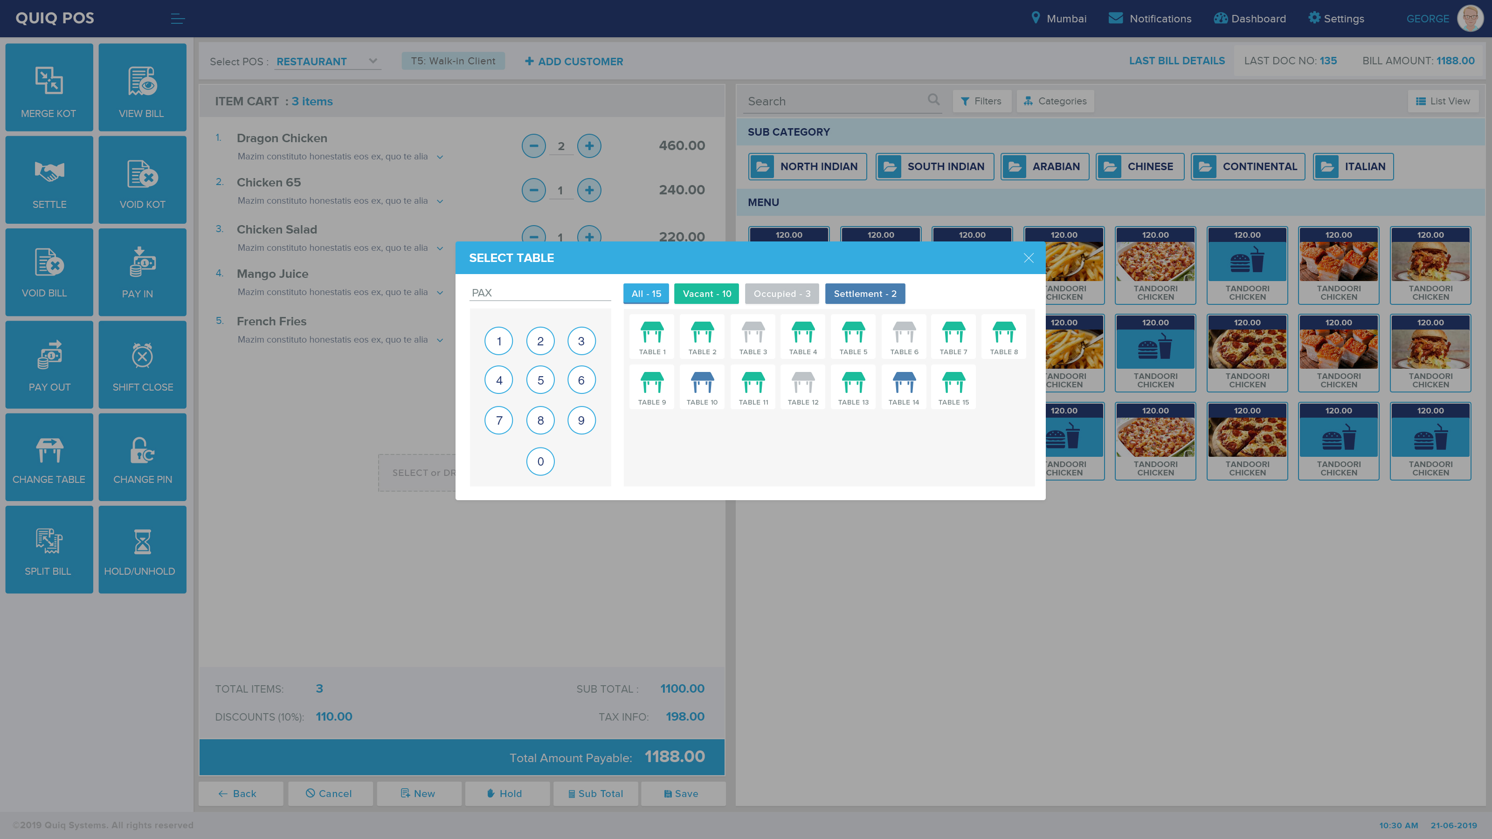
Table selection buttons with count

Slide 8
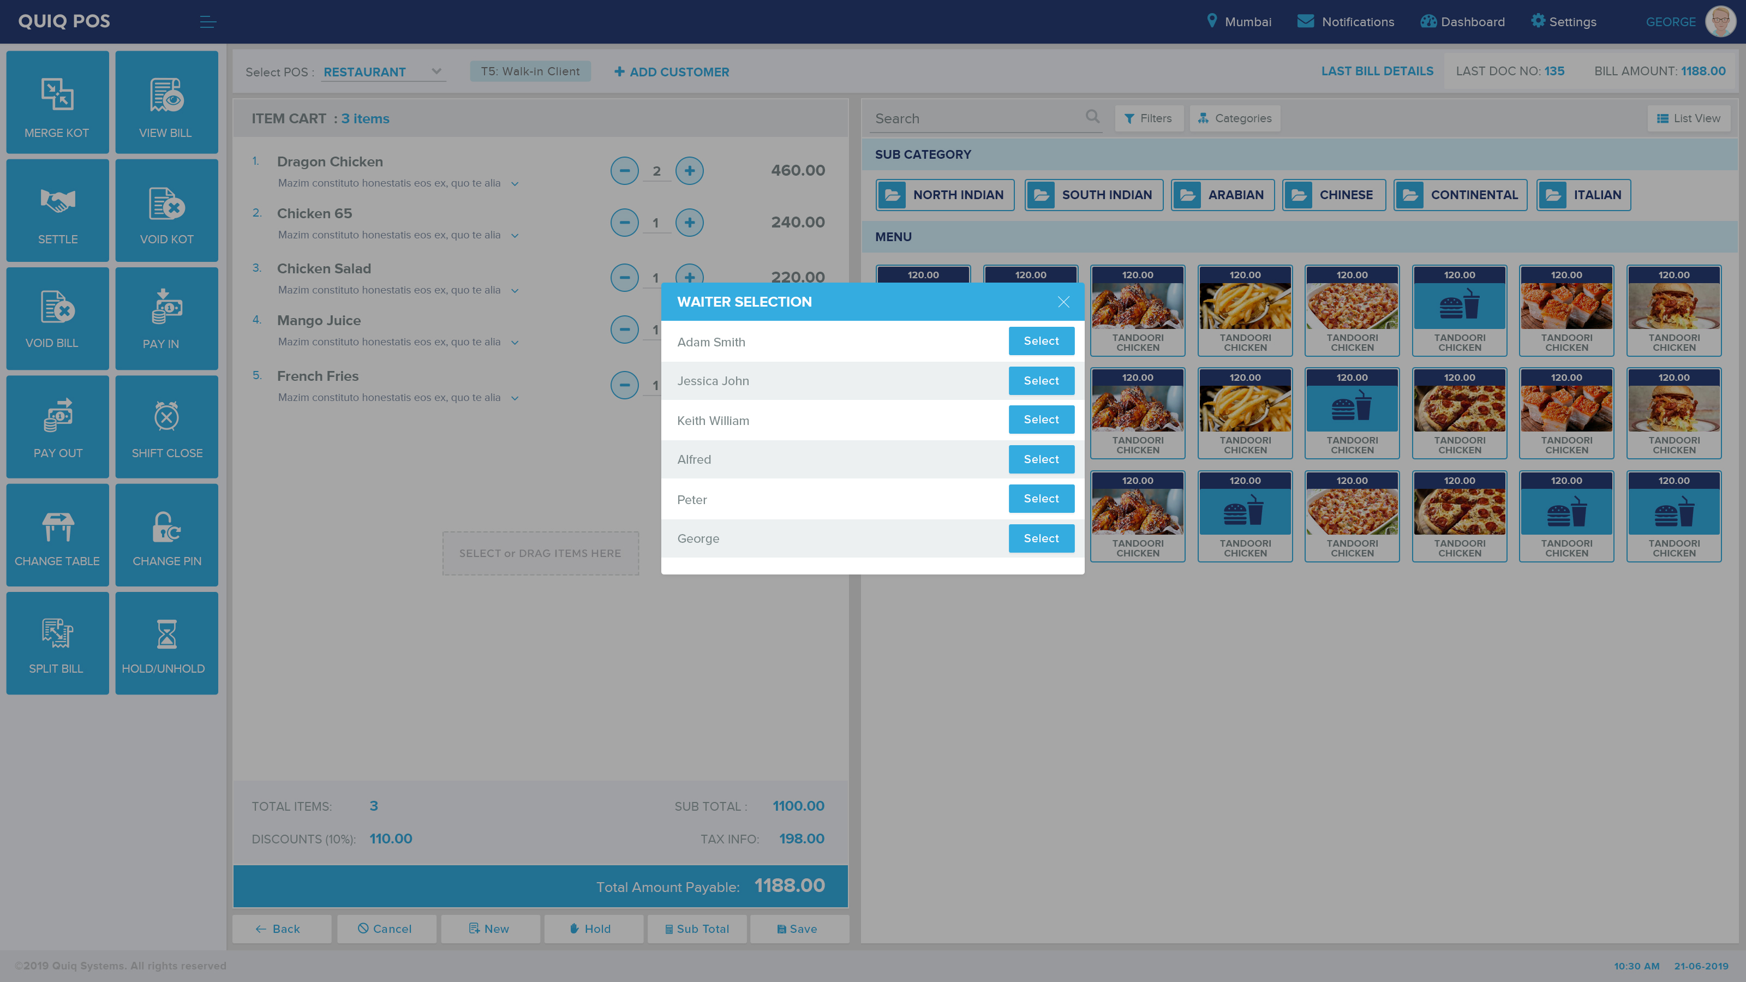
Waiter selection list

Slide 9
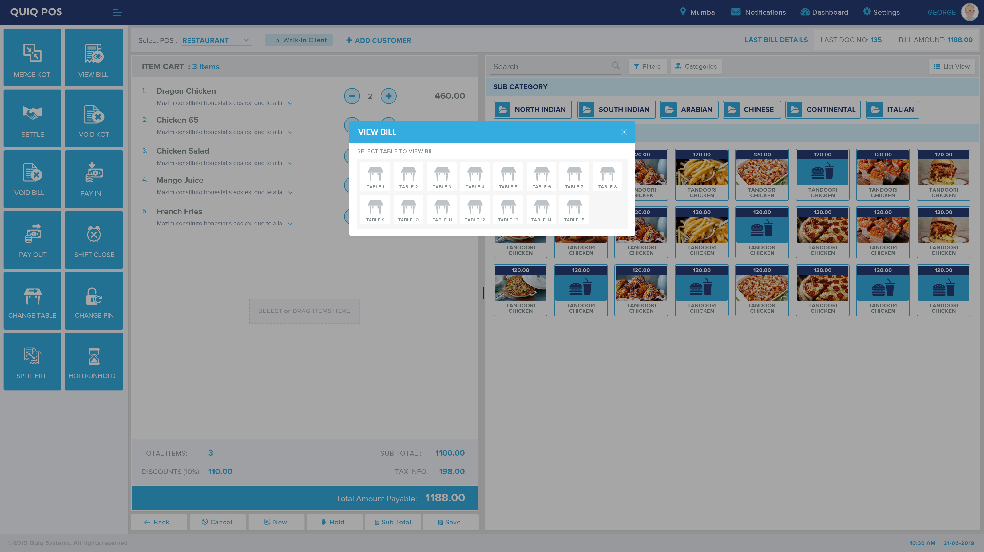
Bill selection pop up

Slide 10
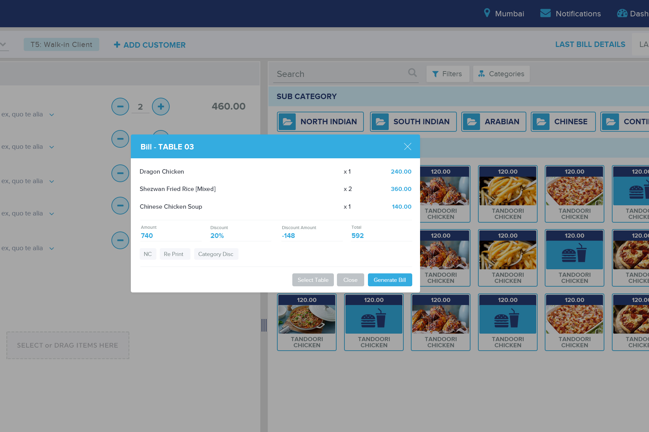
Bill Generation or view bill pop up

Slide 11
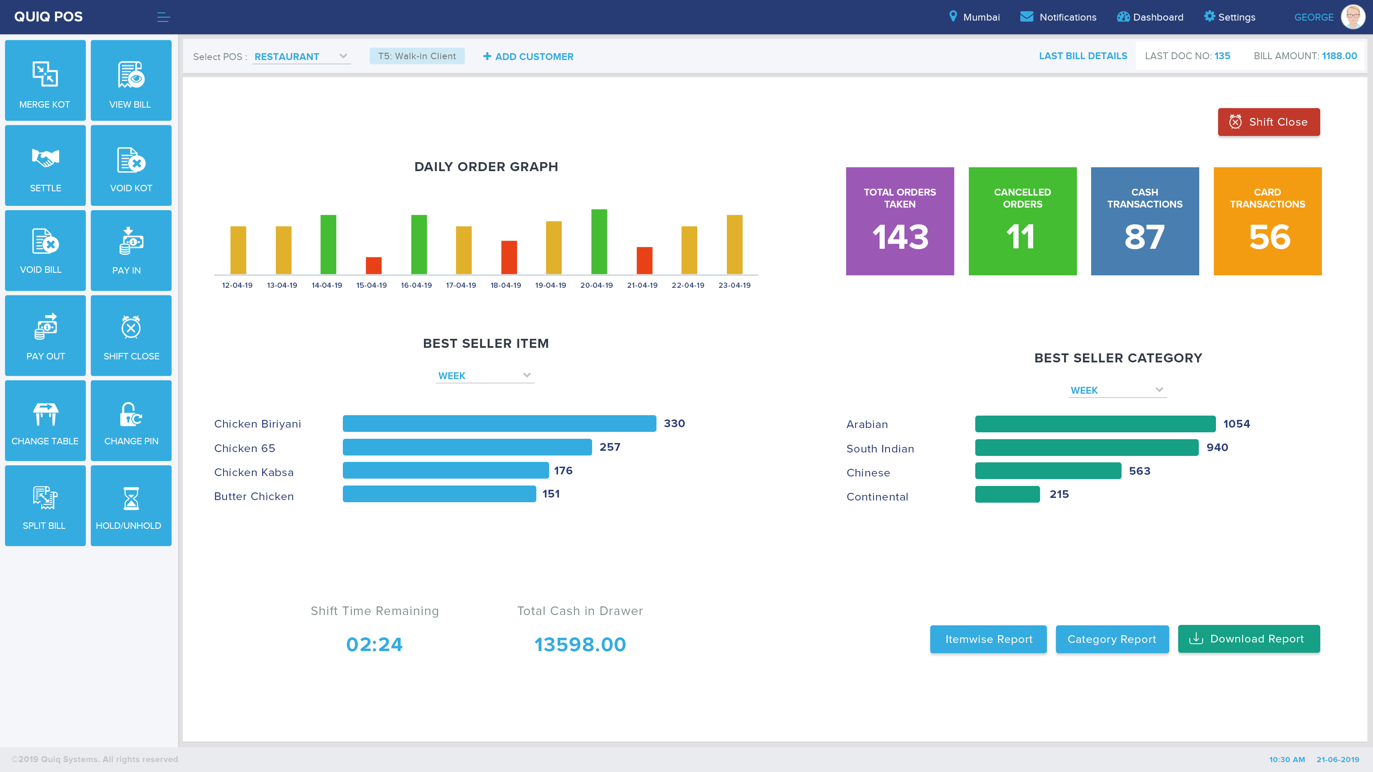
Dashboard

